Slide 1

A Comparative Study of Methods for Mitigating Catastrophic Forgetting in Neural Networks Continual Learning
First Review
Course Code: CS7510
Course Title: Project 2
24MSP3038
Aniket Shinde
28/02/2025

Slide 2
Problem Statement
Neural networks suffer from catastrophic forgetting, where learning new tasks leads to the loss of previously acquired knowledge. This project aims to analyze and compare different approaches for mitigating catastrophic forgetting in continual learning settings. The study evaluates multiple techniques, including regularization-based, replay-based, and architectural methods, using the Split-MNIST dataset to assess their effectiveness in maintaining past knowledge while learning new tasks.
Notes:
There are more techniques like meta-learning, domain adaption which are also useful for certain scenarios but I will be focusing on more primitive techniques for the scope of this project

Slide 3
Objectives
Understand how catastrophic forgetting impedes continual learning in neural networks.
Evaluate and compare various strategies (regularization, replay, architectural) for mitigating forgetting.
Identify key trade-offs (e.g., stability vs. plasticity, accuracy, efficiency) among these approaches.
Derive insights to guide method selection for real-world continual learning applications.
Notes:
Stability: retain knowledge from past tasks
Plasticity: learn new tasks effectively

Slide 4
Review of Related Literature
Base Paper
Title: Three Scenarios for Continual Learning
Author(s): Gido M. van de Ven & Andreas S. Tolias
Journal: NeurIPS Continual Learning Workshop (2018)
Year of Publication: 2019
Methodology:
Defined three continual learning scenarios: Task-IL, Domain-IL, Class-IL.
Compared different regularization, replay, and architectural methods on Split-MNIST and Permuted-MNIST benchmarks.
Used extensive experimental evaluation to assess method effectiveness across different scenarios.
Notes:
Incremental Learning
Task-IL: The model is explicitly given task identity and only classifies among the classes for that specific task. Each task is treated independently.
Domain-IL: The model is not given task identity and must classify from all possible classes in each task. However, tasks share the same label space, differing only in input characteristics (e.g., rotation, noise, color, etc.).
Class-IL: The model is not given task identity and must classify from all classes seen up to that point in a single unified output layer. Each task introduces new classes, and the model must integrate them into a growing classifier.

Slide 5
Review of Related Literature
Outcomes:
Regularization-based methods (e.g., EWC, SI) fail when task identity is not provided.
Replay-based methods perform best in more challenging scenarios (Class-IL).
Architectural methods work well when task identity is available (Task-IL).
Points considered for methodology:
Analyzing method performance across different evaluation settings
Studying the impact of task labels on method effectiveness
Assessing forgetting over time using performance metrics
Notes:
Elastic Weight Consolidation, Synaptic Intelligence
Regularization → Prevents catastrophic forgetting by penalizing changes to important weights, ensuring past knowledge is preserved.
Replay → Stores or generates past data and reintroduces it during training, helping the model retain knowledge of previous tasks.
Architectural → Modifies the network structure to allocate separate resources for new tasks, preventing interference with old knowledge.

Slide 6
Dataset
Source of the Dataset: Yann LeCun, Corinna Cortes, Christopher J.C. Burges. "The MNIST Database of handwritten digits". http://yann.lecun.com/exdb/mnist/
No. of Observations: Training Samples: 60,000
Test Samples: 10,000
Column/Feature Details: Input Shape: (1, 28, 28)
No. of Classes: 10 (0-9 digits)

Slide 7
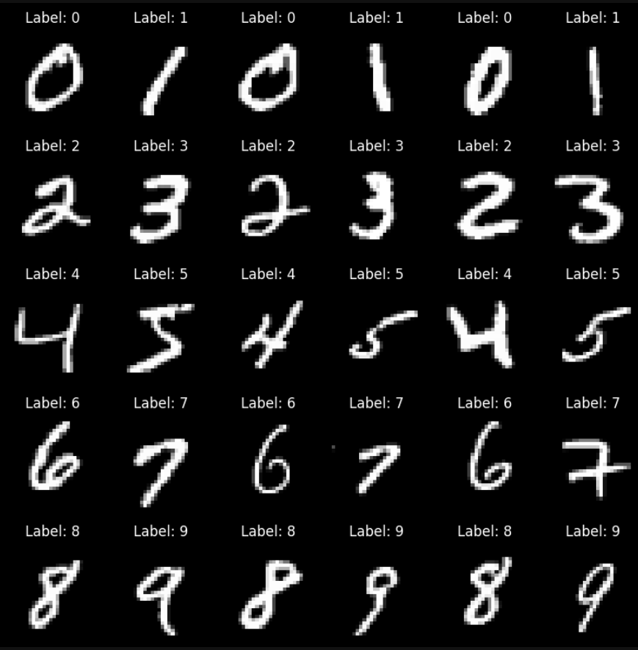
Dataset
Screenshot of the dataset:

Slide 8
Proposed Methodology
Data Preparation
Exploratory Data Analysis
Analysis of Catastrophic Forgetting
Performance Evaluation
Training Across Learning Scenarios
Model Implementation
Conclusion
Notes:
Forgetting analysis using vanilla sgd, performance over time task-IL
Train models using methods on the two scenarios task il and class il

Slide 9
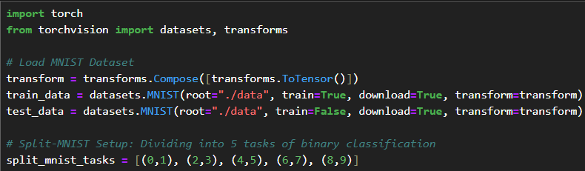
Preprocessing
The MNIST dataset was loaded and split into five binary classification tasks (Split-MNIST) for continual learning experiments.
Notes:
Task-IL

Slide 10
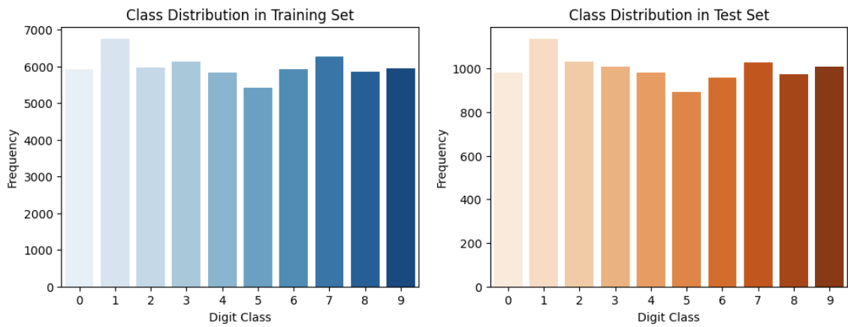
Exploratory Data Analysis
The plot shows the distribution of digit classes (0-9) in a training dataset, with each class having a relatively similar frequency, indicating a fairly balanced dataset.

Slide 11
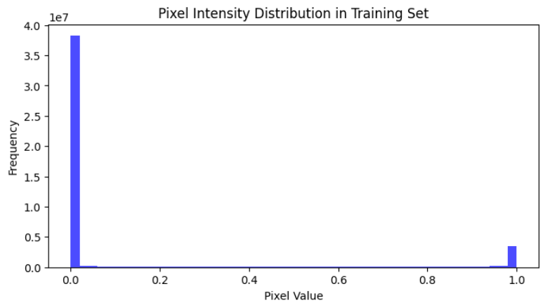
Exploratory Data Analysis
The pixel intensity distribution shows that MNIST consists primarily of black background (0) and white handwritten strokes (1), with minimal mid-range values, ensuring the dataset does not need to be corrected for noise.

Slide 12
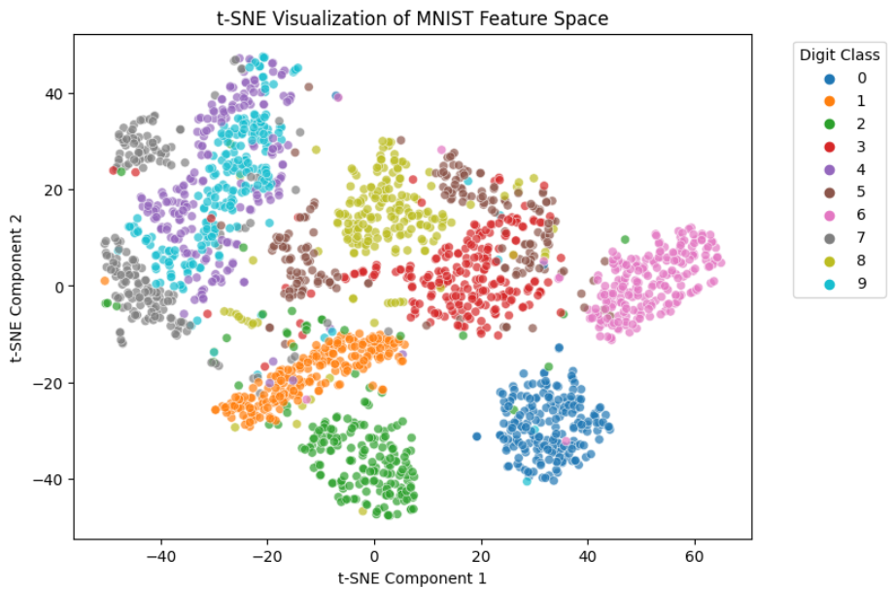
Exploratory Data Analysis
The t-SNE plot reveals that while most digit classes form distinct clusters, some visually similar digits exhibit overlapping regions, suggesting that a simple classifier may not achieve high classification accuracy.

Slide 13
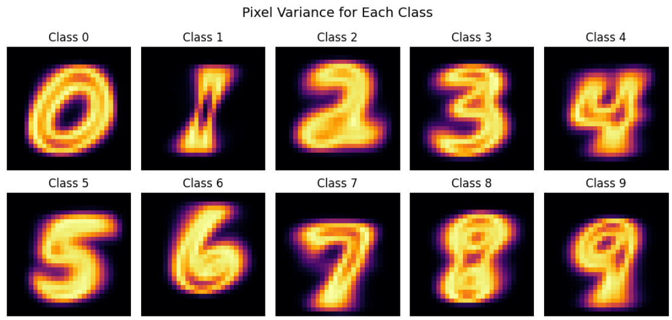
Exploratory Data Analysis
This plot visualizes the variation in pixel intensity within each digit class. Digits like 4 and 7 show high variance due to differing handwriting styles, which could make them more challenging for models to classify accurately.

Slide 14
Next Step of Research Focus
Baseline Forgetting Analysis → Train a simple model with Vanilla SGD to observe catastrophic forgetting.
Implement Continual Learning Methods → Apply Regularization-Based (EWC, SI), Replay-Based (Experience Replay), and Task-Specific (PackNet) methods.
Train Models Across Learning Scenarios → Evaluate methods under Task-IL, Domain-IL, and Class-IL settings.
Notes:
Stochastic Gradient Descent

Slide 15
Conclusion
In conclusion, the data is prepared and ready for training neural network classifiers. The next step is to analyze the effects of catastrophic forgetting over time using Vanilla SGD before implementing mitigation techniques.

Slide 16
References : APA format
Base Paper:
Van de Ven, G. M., & Tolias, A. S. (2019). Three scenarios for continual learning. arXiv preprint arXiv:1904.07734. https://doi.org/10.48550/arXiv.1904.07734
Link to Paper
Paper I:
Wang, L., Zhang, X., Su, H., & Zhu, J. (2024). A comprehensive survey of continual learning: Theory, method and application. IEEE Transactions on Pattern Analysis and Machine Intelligence, 46(8), 5362-5383. https://doi.org/10.1109/TPAMI.2024.3367329
Link to Paper
Paper II:
De Lange, M., Aljundi, R., Masana, M., Parisot, S., Jia, X., Leonardis, A., Slabaugh, G., & Tuytelaars, T. (2022). A continual learning survey: Defying forgetting in classification tasks. IEEE Transactions on Pattern Analysis and Machine Intelligence, 44(7), 3366-3385. https://doi.org/10.1109/TPAMI.2021.3057446
Link to Paper
Paper III:
Lee, C. S., & Lee, A. Y. (2020). Clinical applications of continual learning machine learning. The Lancet Digital Health, 2(6), e279-e281. https://doi.org/10.1016/S2589-7500(20)30102-3
Link to Paper
Paper IV:
Chen, P. H., Wei, W., Hsieh, C.-j., & Dai, B. (2021). Overcoming catastrophic forgetting by generative regularization. arXiv preprint arXiv:1912.01238. https://doi.org/10.48550/arXiv.1912.01238
Link to Paper

